Slide 1




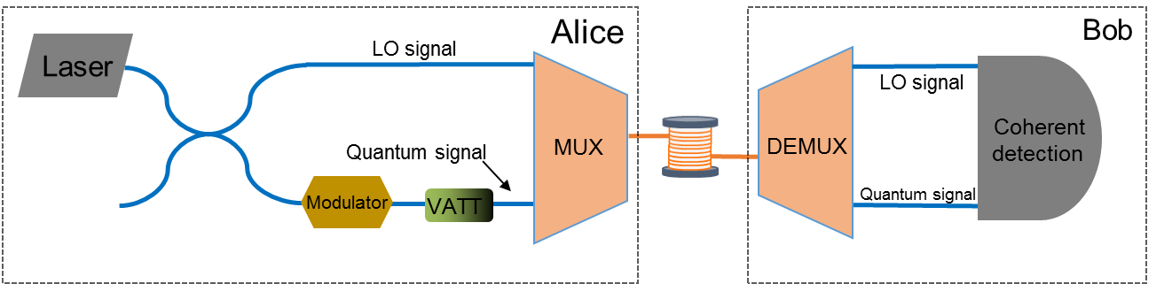
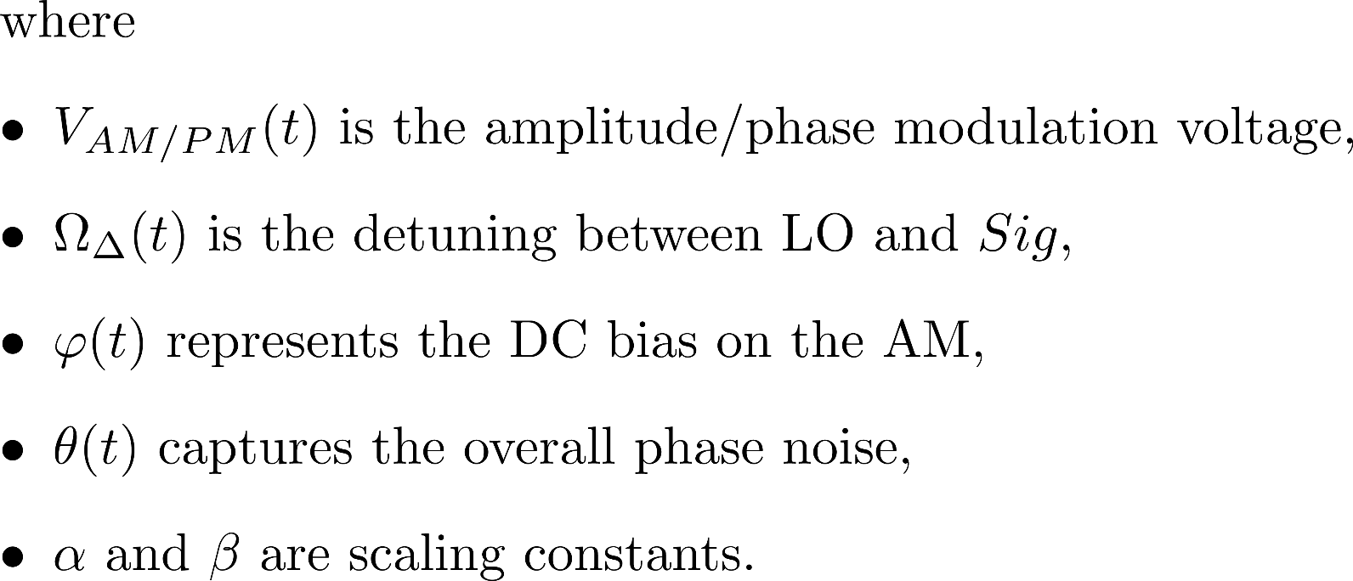
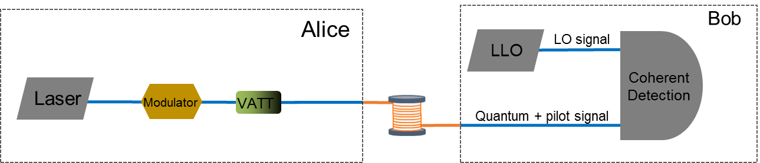

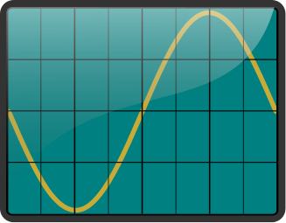
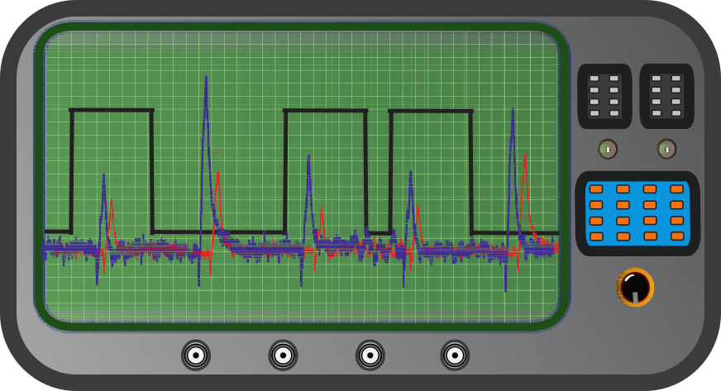
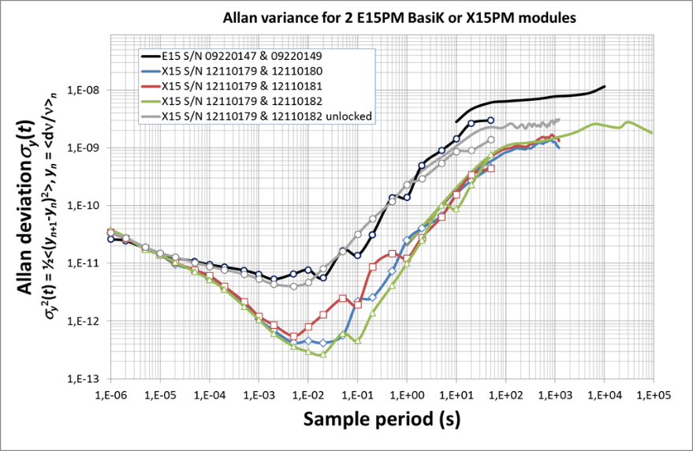
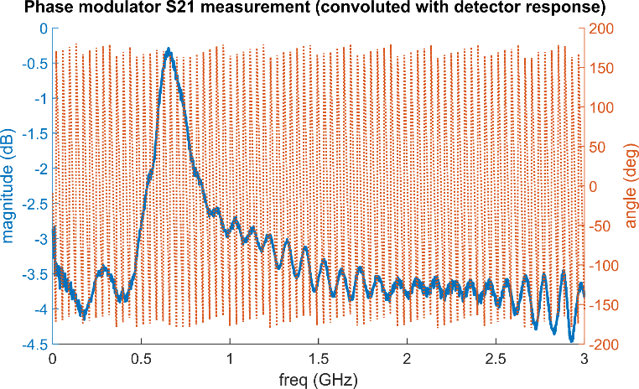
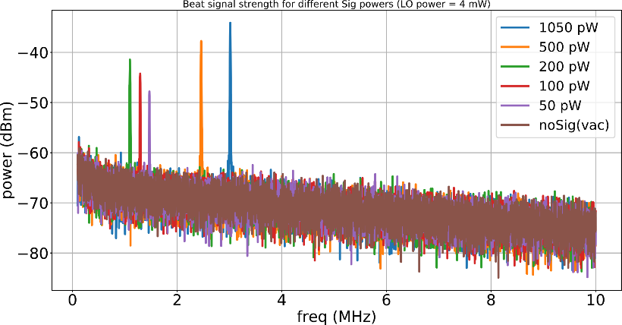
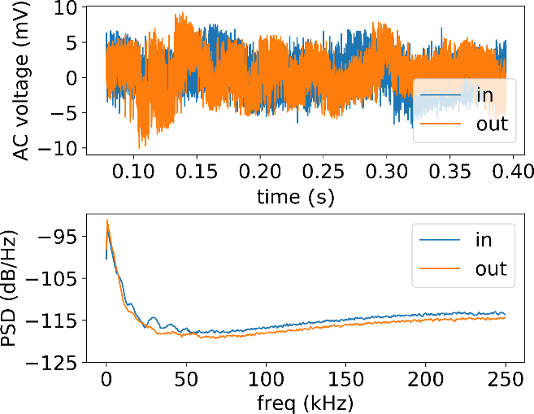
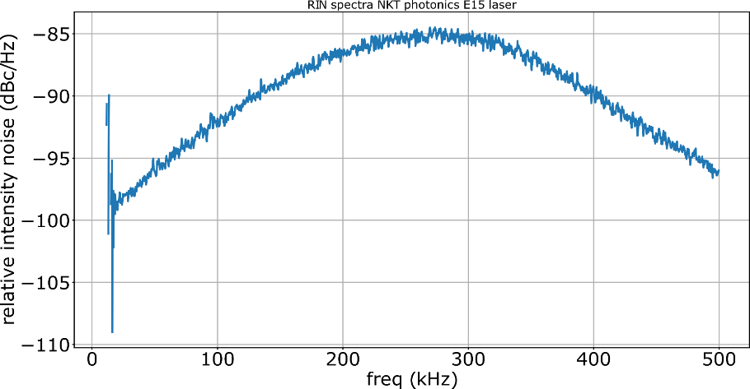
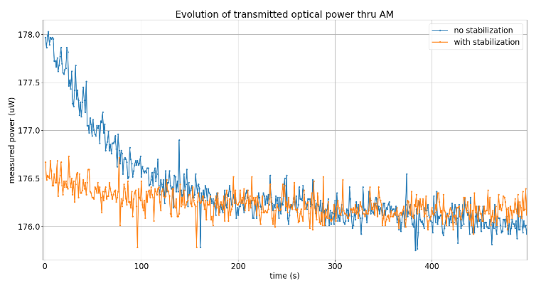
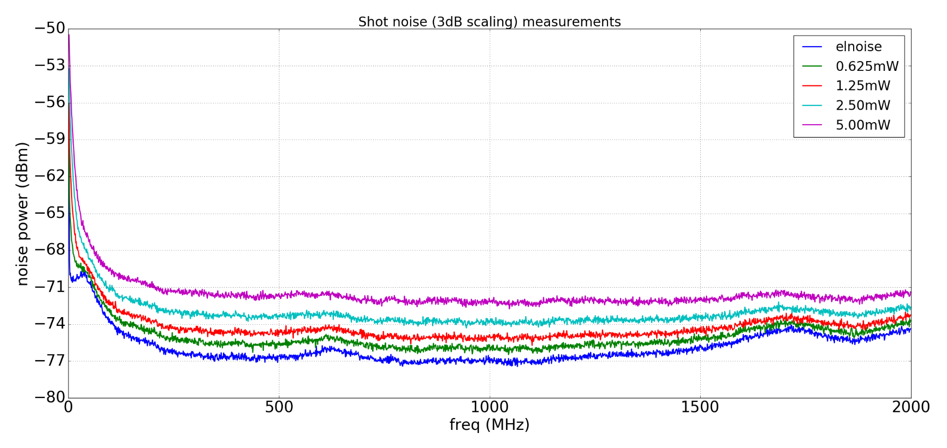
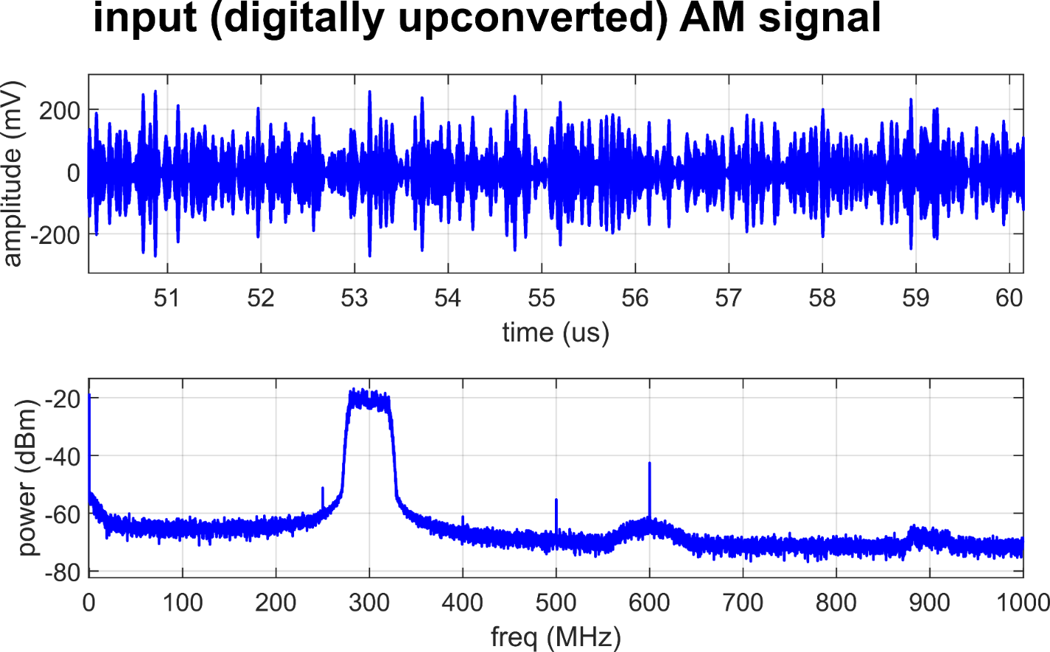
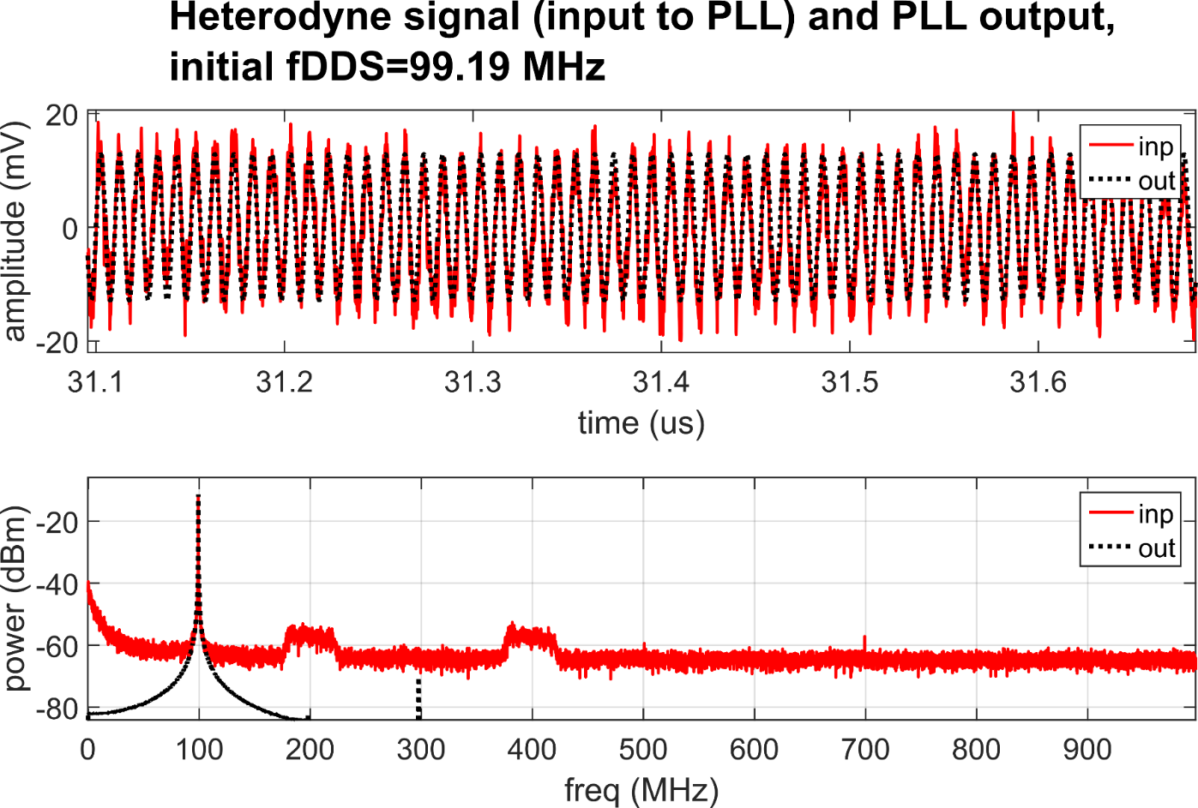
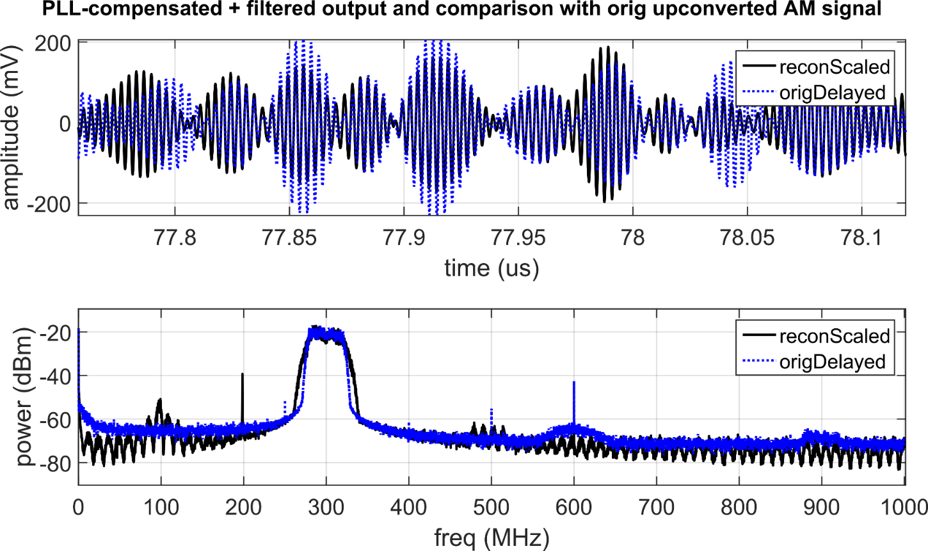
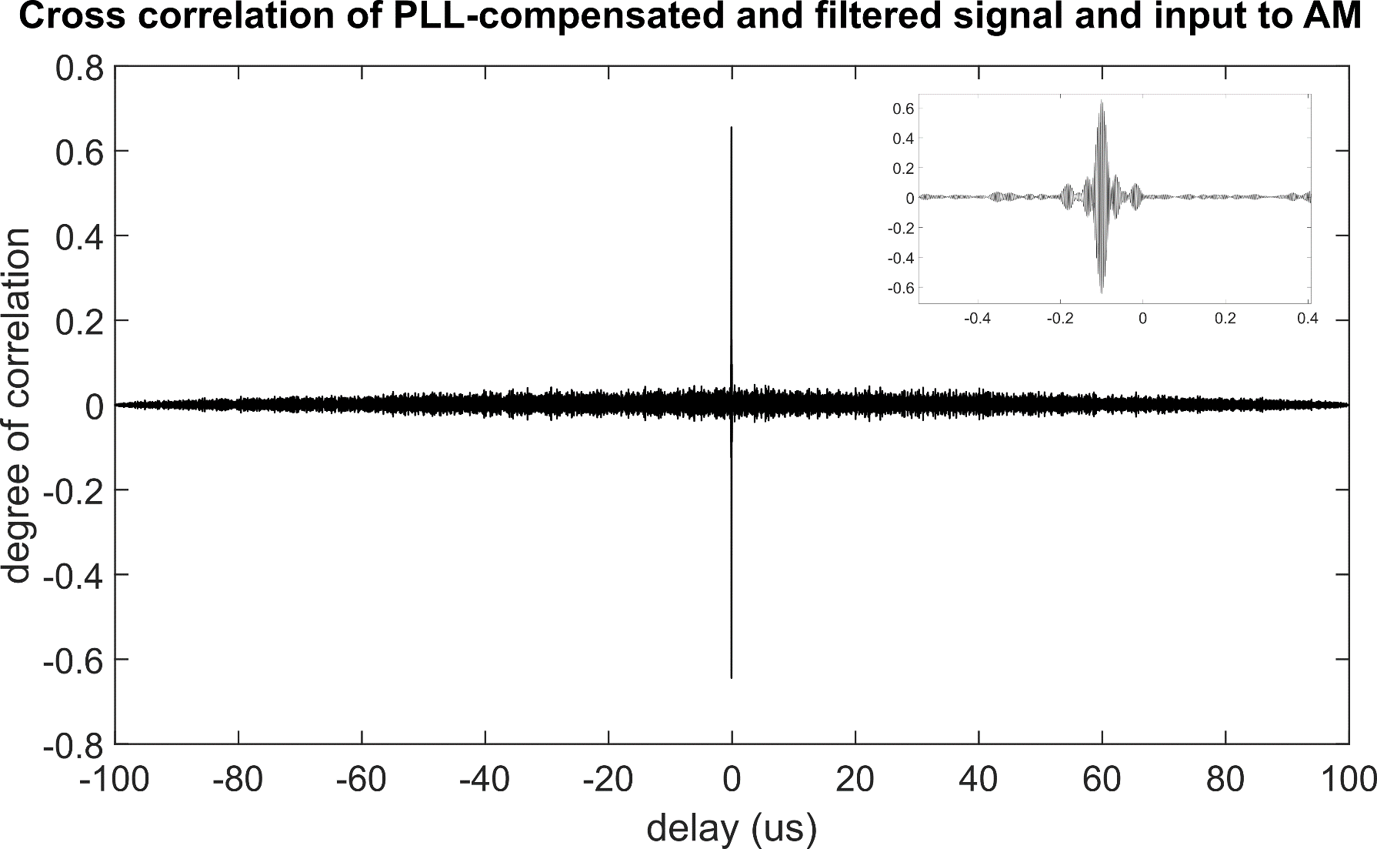
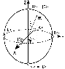
Investigating feasibility of broadband continuous variable quantum key distribution in telecom fibers with local local oscillator
N. Jain,¹ C.S. Jacobsen,¹ D. Solar Nikolic,¹ A. Kordts,¹ C. Lupo,²
R. Grigoryan,¹ T. Pedersen,³ S. Pirandola,^{2,4} T. Gehring,¹ and U.L. Andersen¹
¹Department of Physics, Fysikvej 309, Technical University of Denmark, 2800 Kongens Lyngby, Denmark
²York Centre for Quantum Technologies (YCQT), University of York, York YO10 5GH, United Kingdom
³Cryptomathic A/S, Jaegergardsgale 118, 8000 Aarhus, Denmark
⁴Department of Computer Science, University of York, York YO10 5GH, United Kingdom
Introduction
Design dilemmas: transmitted LO vs. local LO & homodyne vs. heterodyne
The use of continuous variable (CV) quantum information carriers, instead of qubits, constitutes a powerful alternative for practical quantum key distribution (QKD) systems. In contrast to qubit-based approaches, CV-QKD implementations rely on standard telecommunication technology (in particular, coherent detection techniques), and thus have the potential to reach Gbit key rates while staying cost-effective.
One way to achieve this is by encoding quantum states in optical sidebands (at sender Alice) and measuring them with a wideband detector (at receiver Bob). Here, we present the progress in realization of such a CV-QKD scheme using coherent states with Gaussian modulation, and the various challenges in adapting the security proof to real-world scenarios.
CV-QKD systems employ receivers performing phase-sensitive detection using a local oscillator (LO) whose phase drift w.r.t. the sent quantum signal (qSig) must be precisely controlled/estimated. Until recently, all known CV-QKD implementations used the transmitted LO (TLO) design. A novel local LO (LLO) design obviates some limitations of the TLO design but brings in some new challenges.
Balanced detection involves interfering the sent signal with the LO on a 50/50 splitter. Depending on the frequency detuning Ω_{Δ} between the signal and LO, one performs homodyne (Ω_{Δ} = 0) or heterodyne detection (Ω_{Δ} ≠ 0). Heterodyning allows recovering the full info about Sig but with a 3dB penalty.
A general expression for the output current of balanced receiver:
Transmitted LO
Difficulty in estimating relative phase between qSig and LO; complicated phase correction using reference signals need to be employed
LO can be fully trusted, security loopholes closed
No limitation on the local LO intensity
Local LO
Stable relative phase between qSig and LO at the receiver
Vulnerable to LO intensity/wavelength manipulation on quantum channel
LO intensity limitation at receiver due to propagation losses and non-linear effects
Assuming small modulation depths, quadrature DC bias on AM, and negligible phase noise and drifts in the setup:
Current setup and component characterization
Ch1
Arbitrary waveform
generator (AWG)
Alice
Ch2
LLO
laser
heterodyne detection
(ω_{b} ≠ 0)
-
Signal
laser
Intensity
modulator
(IM)
Phase
modulator
(PM)
Variable
attenuator
(VATT)
Quantum
channel
Bob
polarization maintaining fiber
single mode fiber
Caption for beat signal strength
measurements
Caption for shot noise
measurements
Figure 1. shows the measured Allan variance for X15 and E15 lasers
by NKT Photonics.
Figure 2. shows relative intensity noise for the E15 laser.
Broadband coding requires a thorough pre-characterization of the modulators and detector
response (transfer function) in the frequency band of interest.
Figure 1. shows the network analyzer measurement results of S21 parameter for the phase
modulator. Figure 2. shows the effects of stabilization of transmitted optical power through
the amplitude modulator as a function of time.
Cpation for polarization drift measurements
Preliminary results (back to back configuration)
Data processing performed offline in MATLAB with digital PLL for recovering the modulated data
The current setup employs amplitude and phase modulators which create double sideband
Future steps
QRNG
FPGA
(RF mod)
VATT
PMF
SMF
Security analysis
The future setup will use single-sideband modulation for better spectral efficiency and closing potential security loopholes
Introduction of pilot signals for clock recovery, multiplexed in time with the quantum signal
Carrier synchronization on receiver side
Replacing AWG and oscilloscope with FPGA DAC/ADC suite for online signal generation and recovery
laser
IQmod
A composable security proof for the most general attacks in Gaussian CV-QKD systems is still an open problem
It is proved that the system is secure against collective attacks for continuous Gaussian modulation of coherent states; this is very important result since general coherent attacks will be possible only with very advanced quantum adversary in, what is believed, not so near future
The main focus of our theoretical research is estimating final key length taking into account finite block length and inevitable discretization of Gaussian modulation
Current security proof provides an expression for secret key length:
EQUATION FROM COSMO
½
ADC, clock recovery,
demodulation,
reconstruction etc.
dynamic polarization
controller
heterodyne detection
(ω_{b} ≠ 0)
laser
VATT
[1]
References

